Slide 1

IOT BASED BANK LOCKER SECURITY SYSTEM

Slide 2
INTERFACING OF RTC WITH BEAGLEBONE BLACK
SUBMITTED BY: KIRANPREET KAUR GILL(CO761396)
GROUP: #2

Slide 3
TABLE OF CONTENT
PROJECT OVERVIEW
UNTIL NOW
TASK OBJECTIVES
REQUIREMENTS
HARDWARE REQUIREMENTS
SOFTWARE REQUIREMENTS
INTRODUCTION OF BEAGLEBONE BLACK
FEATURES
PIN LAYOUT
INTRODUCTION OF RTC MODULE
FEATURES
PIN LAYOUT
ROLE OF RTC MODULE
COMMUNICATION PROTOCOL
INTERFACING OF RTC MODULE WITH BEAGLEBONE BLACK
SCHEMATIC DIAGRAM
CONNECTIONS
LIBRARIES INCLUDED FOR INTERFACING
CODING
TERMINAL COMMANDS
OUTPUT
REFERENCES

Slide 4
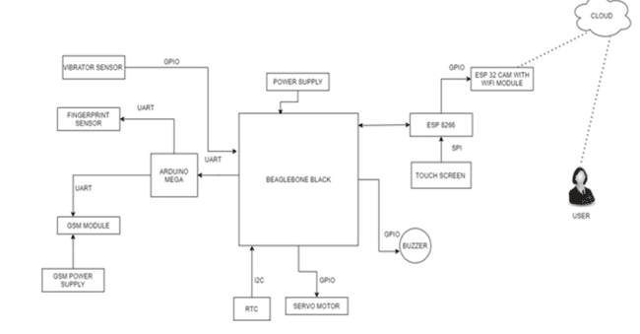
PROJECT OVERVIEW

Slide 5
UNTIL NOW
After the successful interfacing of buzzer, Servo motor, Vibration sensor, Arduino mega, Fingerprint sensor, GSM SIM900 Module, ESP8266 Module, ESP32 Module, and Touchscreen with beaglebone black. The only interfacing that is left is RTC Module.
For RTC Module interfacing, I2C communication protocol is used whereas GPIOs pins are used for interfacing of buzzer, Servo motor, Vibration sensor, ESP8266, ESP32 except the fingerprint sensor, Arduino Mega in which UART was used and Touchscreen that used SPI communication protocol.
For interfacing of RTC Module with Beaglebone Black I2C communication protocol is used.

Slide 6
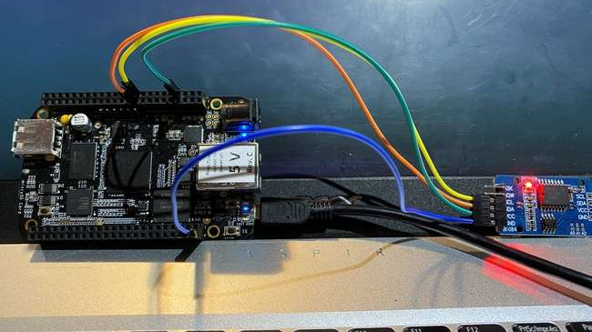
TASK OBJECTIVES
To interface the RTC(Real-Time Clock) with the Beaglebone Black.
The coding will be done to it compatible with the mentioned objective.
The interfacing is done so as to keep track of the real-time and date.

Slide 7
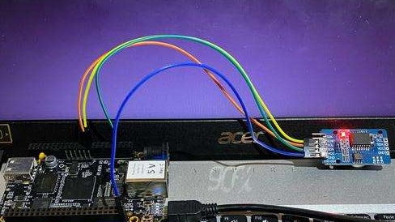
REQUIREMENTS
There are some hardware and software requirements for the interfacing of RTC Module with Beaglebone Black.

Slide 8

HARDWARE REQUIREMENTS
Beaglebone Black
RTC Module
USB Cable
3V Lithium Battery
Jumper Wires

Slide 9

SOFTWARE REQUIREMENTS
Terminal
GNU NANO Editor
GCC Compiler

Slide 10
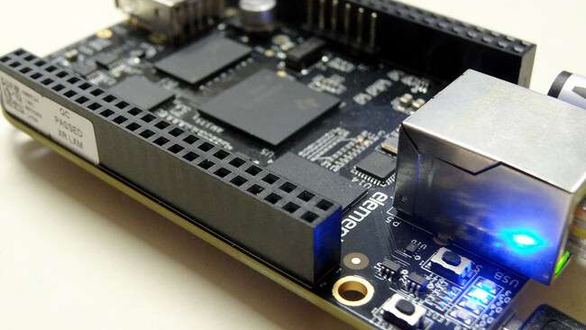
INTRODUCTION TO BEAGLEBONE BLACK
Beaglebone Black is our main microcontroller unit as all the components are connected directly or indirectly with the beaglebone black.
It is a low-cost, community-supported development platform.
This Photo by Unknown Author is licensed under CC BY-NC

Slide 11
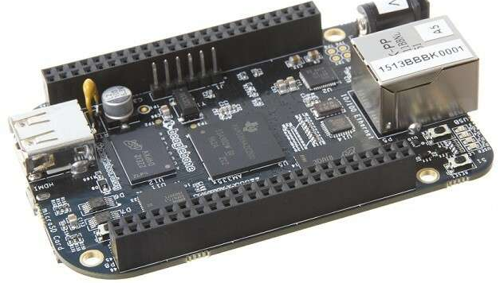
FEATURES
It has a range of IO including USB, SPI, I2C, UART, LCD, and GPIOs.
Connectivity
USB client for power & communications
USB host
Ethernet
HDMI
2x 46 pin headers
Software Compatibility
Debian
Android
Ubuntu
This Photo by Unknown Author is licensed under CC BY-SA

Slide 12
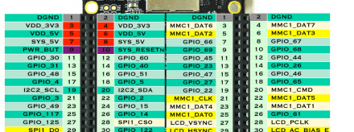
PIN LAYOUT
This Photo by Unknown Author is licensed under CC BY-SA
The beaglebone black’s pin 19, 20, Vcc of header 9 and GND are used.

Slide 13
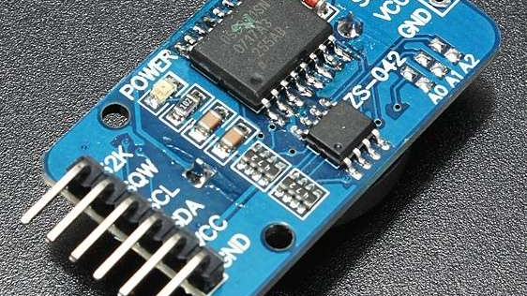
INTRODUCTION TO RTC MODULE
The DS3231 is a low-cost, extremely accurate I2C real-time clock (RTC) with an integrated temperature compensated crystal oscillator (TCXO) and crystal. The device incorporates a battery input and maintains accurate timekeeping when main power to the device is interrupted.
The RTC maintains seconds, minutes, hours, day, date, month, and year information. The date at the end of the month is automatically adjusted for months with fewer than 31 days, including corrections for leap year.
This Photo by Unknown Author is licensed under CC BY-SA

Slide 14
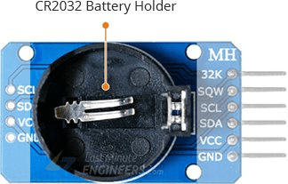
RTC MODULE: BATTERY BACKUP
The DS3231 incorporates a battery input and maintains accurate timekeeping when main power to the device is interrupted.
The bottom side of the board holds a battery holder for 20mm 3V lithium coincells. Any CR2032 battery can fit well.

Slide 15
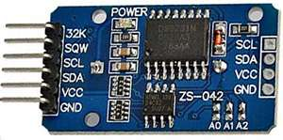
FEATURES
Can function with low voltages
A programmable Square-wave output as per requirement
A battery backup to stay updated even if there is no power
A dual-directional, 400 kHz of I2C interface for speedy transmission
32 bytes of EEPROM for to read/write or to save data
A pushbutton to reset time
RTC can be used either in 12hrs or 24hrs format
An aging trim register to set a user-provided value as an offset with reference to the factory value
Maintains seconds, minutes, hours, days, weeks, months, years information
Switches automatically from a power source to an in-built battery source
This Photo by Unknown Author is licensed under CC BY-SA

Slide 16
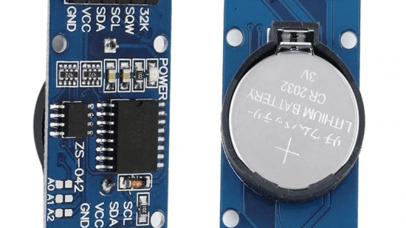
FRONT AND BACK VIEW OF RTC MODULE

Slide 17
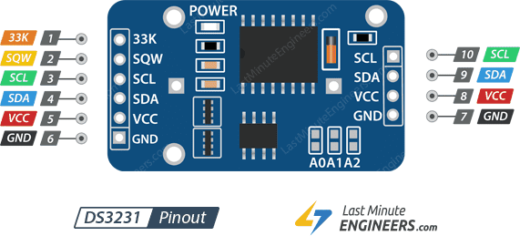
PIN LAYOUT

Slide 18
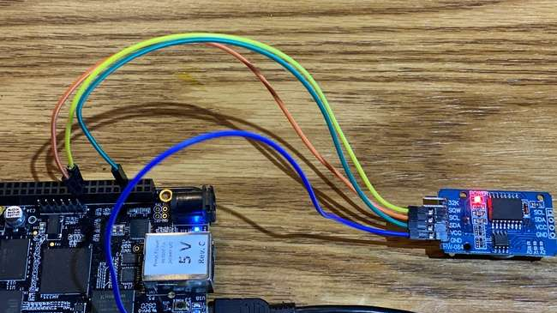
ROLE OF RTC MODULE
Real time clock (RTC) allows microcontroller project to keep track of time.
We are using RTC for keeping track or real time.

Slide 19
INTERFACING OF RTC MODULE WITH BEAGLEBONE BLACK
Real time clock is connected using I2C communication protocol.
RTC is connected directly to the beagle bone to determine the real time on screen as BBB does not have inbuilt RTC.
RTC DS3231 | BEAGLEBONE BLACK
SCL | P9.19
SDA | P9.20
VCC | VCC
GND | GND

Slide 20
COMMUNICATION PROTOCOL
For interfacing of RTC Module with Beaglebone Black “I2C Communication Protocol” is used.

Slide 21

I2C COMMUNICATION PROTOCOL
I2C communication is the short form for inter-integrated circuits. It is a communication protocol developed by Philips Semiconductors for the transfer of data between a central processor and multiple ICs on the same circuit board using just two common wires.
This is a type of synchronous serial communication protocol. It means that data bits are transferred one by one at regular intervals of time set by a reference clock line.

Slide 22
FEATURES
The following are some of the important features of I2C communication protocol:
Only two common bus lines (wires) are required to control any device/IC on the I2C network
No need of prior agreement on data transfer rate like in UART communication. So, the data transfer speed can be adjusted whenever required.
Simple mechanism for validation of data transferred
Uses 7-bit addressing system to target a specific device/IC on the I2C bus.
I2C networks are easy to scale. New devices can simply be connected to the two common I2C bus lines.

Slide 23
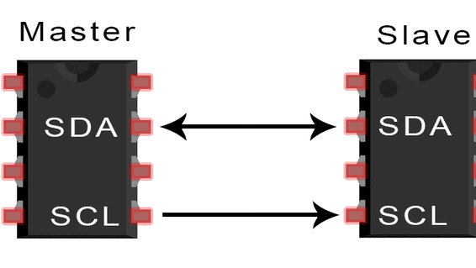
I2C COMMUNICATION PROTOCOL
Like UART communication, I2C only uses two wires to transmit data between devices:
SDA (Serial Data) – The line for the master and slave to send and receive data.
SCL (Serial Clock) – The line that carries the clock signal.

Slide 24
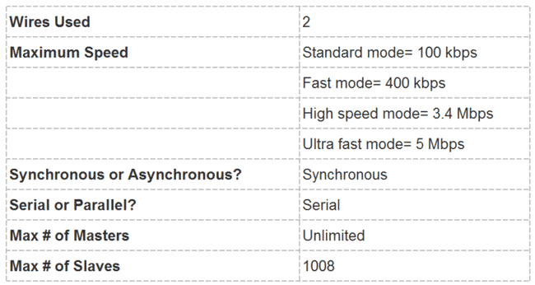
I2C COMMUNICATION PROTOCOL
Like SPI, I2C is synchronous, so the output of bits is synchronized to the sampling of bits by a clock signal shared between the master and the slave. The clock signal is always controlled by the master.

Slide 25
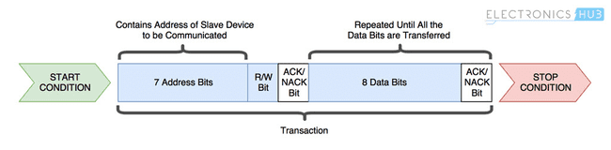
HOW I2C COMMUNICATION PROTOCOL WORKS ??
The following protocol (set of rules) is followed by master device and slave devices for the transfer of data between them.
Data is transferred between the master device and slave devices through a single SDA data line, via patterned sequences of 0’s and 1’s (bits). Each sequence of 0’s and 1’s is termed as a transaction and the data in each transaction is structured as below:

Slide 26
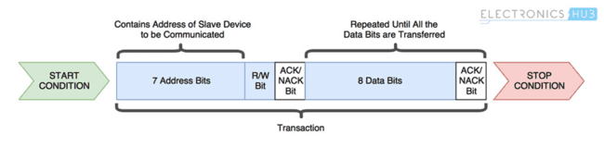
HOW I2C COMMUNICATION PROTOCOL WORKS ??
Start Condition: Whenever a master device/IC decides to start a transaction, it switches the SDA line from high voltage level to a low voltage level before the SCL line switches from high to low. Once a start condition is sent by the master device, all the slave devices get active even if they are in sleep mode and wait for the address bits.
Stop Condition: After required data blocks are transferred through the SDA line, the master device switches the SDA line from low voltage level to high voltage level before the SCL line switches from high to low.
Address Frame: It comprises of 7 bits and are filled with the address of slave device to/from which the master device needs send/receive data. All the slave devices on the I2C bus compare these address bits with their address

Slide 27

HOW I2C COMMUNICATION PROTOCOL WORKS ??
Read/Write Bit: This bit specifies the direction of data transfer. If the master device/IC need to send data to a slave device, this bit is set to ‘0’. If the master IC needs to receive data from the slave device, it is set to ‘1’.
ACK/NACK Bit: It stands for Acknowledged/Not-Acknowledged bit. If the physical address of any slave device coincides with the address broadcasted by the master device, the value of this bit is set to ‘0’ by the slave device. Otherwise it remains at logic ‘1’ (default).

Slide 28
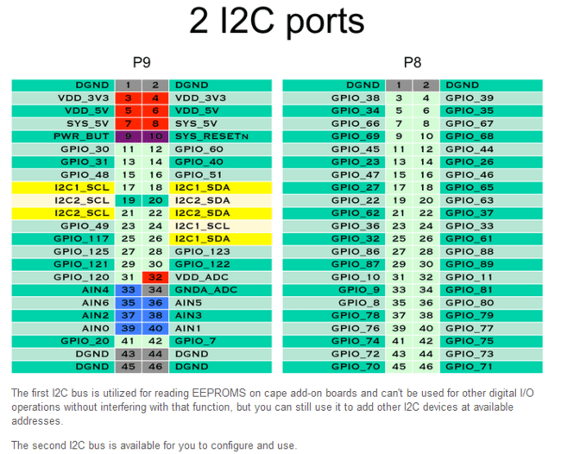
I2C PORTS IN BEAGLEBONE BLACK

Slide 29
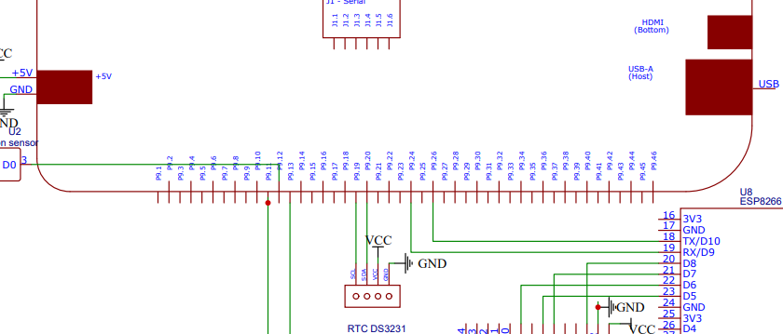
SCHEMATIC DIAGRAM

Slide 30
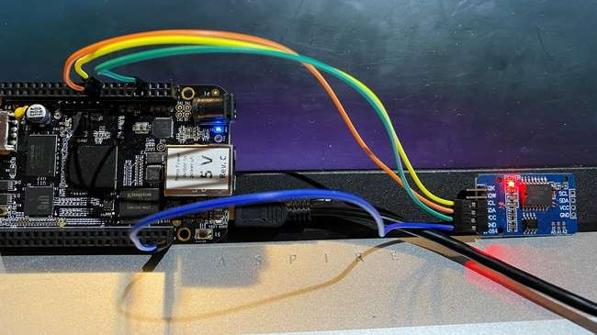
CONNECTIONS OF RTC MODULE WITH BEAGLEBONE BLACK

Slide 31
LIBRARIES USED FOR THIS INTERFACING
stdio.h
Standard C input Output Library.
unistd.h
defines miscellaneous symbolic constants and types and declares miscellaneous functions.
stdlib.h
Includes some standard C libraries used for triggering command line.

Slide 32
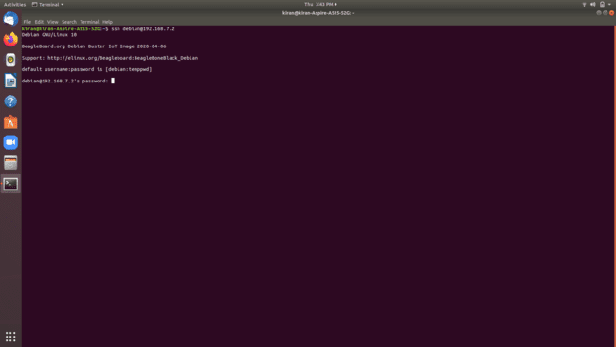
TERMINAL COMMANDS
Enter password here
STEP 1: Enter the command “ssh debian@192.168.7.2” here ssh command instruct the system to establish an encrypted secure connection with the host machine. Debian here represent the user_name that is being accessed on the host and then it is followed by an IP address.
STEP2: Before continue to next step, the password “temppwd” must be entered.

Slide 33
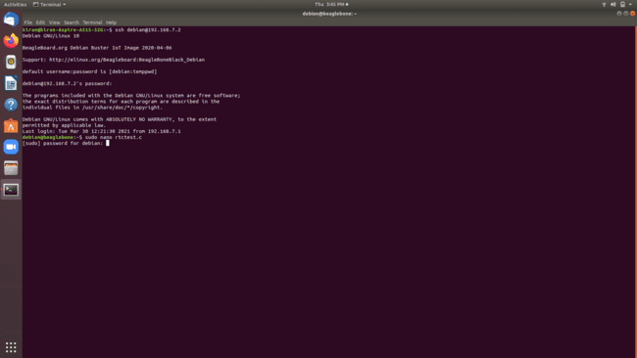
TERMINAL COMMANDS
STEP 3: Enter the command “rtctest.c” to open Nano text editor and to directly write, edit and navigate the code and to get immediate onscreen feedback. Here, rtctest.c is the file name. Then enter the same password “temppwd.”
Here CTRL+O : save the code; then press enter; CTRL+X : to exit.

Slide 34
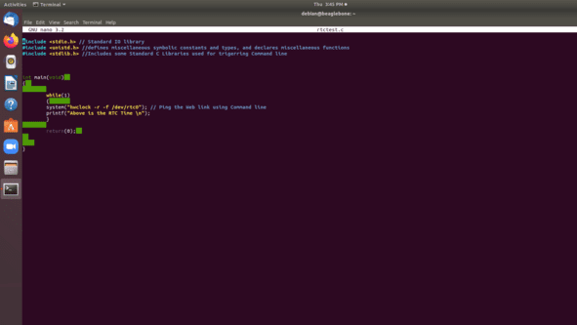
CODING
Libraries used in coding
This command is used to read the time of RTC where r is to read the time and dev/rtc0 defines the “RTC class drivers.”

Slide 35
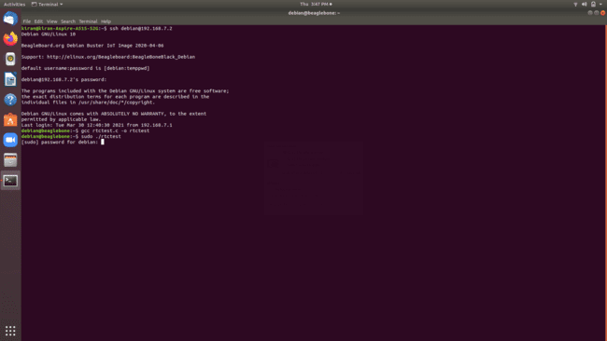
TERMINAL COMMANDS
STEP4: To compile and execute the code, enter the command “gcc rtctest.c -o rtctest.” Here, rtctest.c is the program_name and rtctest is the executable file name. Afterwards, press Enter and write the Executable_name : “sudo ./rtctest.”
STEP5: Again, enter the password: temppwd

Slide 36
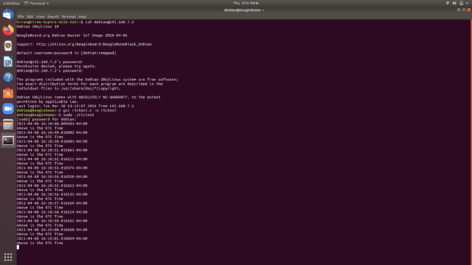
OUTPUT

Slide 37

VIDEO

Slide 38
REFERENCES
I2C Communication Protocol: Basics of the I2C Communication Protocol (circuitbasics.com)
I2C Communication Protocol: Basics of I2C Communication Protocol | Hardware, Data Transfer, Configurations (electronicshub.org)
I2C Communication Port of Beaglebone Black: Beagleboard:Cape Expansion Headers - eLinux.org
RTC Module: https://datasheets.maximintegrated.com/en/ds/DS3231-DS3231S.pdf
RTC Module: https://lastminuteengineers.com/ds3231-rtc-arduino-tutorial/
Interfacing of RTC with beaglebone black: https://learn.adafruit.com/adding-a-real-time-clock-to-beaglebone-black

Slide 39
THANK YOU

